Slide 1

Cyclistic’s Road To Speedy Success
Sayali Shinde
August 2023

Slide 2
Outline of the Presentation
1
2
3
4
5
Purpose
Findings
Recommendations
Summary
Appendix

Slide 3
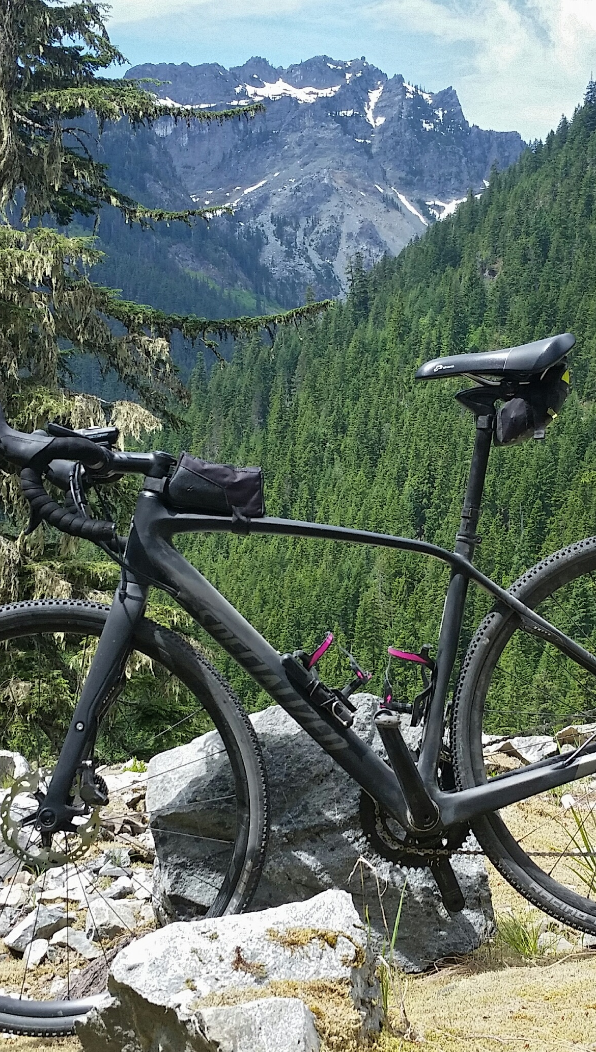
Purpose:
Understand how casual riders and annual members use Cyclistic bikes differently. From these insights, design a new marketing strategy to convert casual riders into annual members.

Slide 4
Finding: Rider Types Percentage
The total number of rides taken from June of 2022 to May of 2023 was 4226423.
Out of this 2541806 number of rides were from riders with annual membership, making up to 60% of the total rides taken.
Most of the riders have annual membership.

Slide 5
Finding: Preferred Rideable Type
Classic bikes are the most popular rideable type. They are also the most popular rideable type among annual membership riders, followed by electric bikes.
Majority of the casual riders prefer to ride electric bikes, followed by docked biked.
None of the annual membership riders prefer using docked bikes.

Slide 6
Finding: Popular Week Day For Riders
For casual riders, the most popular days are Saturday and Sunday, respectively.
For annual membership riders, the most popular days are Wednesday and Tuesday, respectively.
Overall, Saturday has the most number of total riders.
Casual riders mostly rent bikes on weekends while members use them consistently throughout the week.

Slide 7
Finding: Popular Hour For Riders
The number of bike rentals by both casual and annual membership riders peak at 5 PM.
The numbers of casual riders grows gradually throughout the day, peaking at 5 PM.
Whereas, there are significant peaks in the number of annual membership riders during the morning hours and later around 5 PM.

Slide 8
Finding: Popular Month For Riders
For casual riders, the most popular month is July.
For annual membership riders, the most popular month is August.
There is a clear rise in the number of rides taken in the months of summer.

Slide 9
Finding: Top 10 Start Stations
The most popular start station for casual riders is 'Kingsbury St & Kinzie St’.
For annual membership riders, it is 'Streeter Dr & Grand Ave'. Streeter Dr & Grand Ave is also the most popular start station in general.

Slide 10
Findings Summary
What makes membership riders different from casual riders?
Rideable Type
Week Day
Month
Hour
Start Station
10
Cyclistic Bike-Share

Slide 11
RECOMMENDATIONS
Electric Bikes
Seasonal Membership
Popular Start Stations
Most casual riders prefer electric bikes.
Offering subscriptions to electric bikes at a discounted price can encourage more casual riders to buy a membership.
​
There is spike in riders during the summer months
Designing a different of membership plan for seasonal riders will help boost number of membership riders.
Similarly, a different plan for weekends can be created.
Out of the top 10 start stations, only 4 have above 50% of the riders with an annual membership.
The other 6 stations should be targeted during marketing campaigns to increase the percentage of membership riders.

Slide 12

Summary
The casual riders will buy a membership if offered at an discounted price. Introducing new membership plans that cater to user preferences will also help in increasing the member count.
Emails and social media can be used to advertise the plans and discounts. Physical Ads can be placed at popular stations.

Slide 13

Thank you
Sayali Shinde
sayalis0910@gmail.com

Slide 14





A P P E N D I X
Data Source
Data Cleaning
Assumptions
Data Transformation
Improvements

Slide 15
A P P E N D I X
Data Source
Data Cleaning
Assumptions
Cyclistic Trip Data
(June 2022 To May 2023)
License
Irrelevant columns dropped.
Null values and duplicates removed.
Full Process
We assumed that it is reliable, original, comprehensive, current, non-biased and was collected ethically.
Trips with ride length zero are considered as data entry error and are dropped.

Slide 16
A P P E N D I X
Data Transformation
Improvements
Adding month, weekday, hour and other relevant data columns.
Transform data types.
Removing outliers based on calculation of ride length.
Full Process
Demographic data like age, gender, location was not provided.
Adding this information can segment their customers into separate groups based on their habits, interests, and other important characteristics.

